Slide 1
Registration on Coaching Portal
Coaching Department (AIFF)

Slide 2
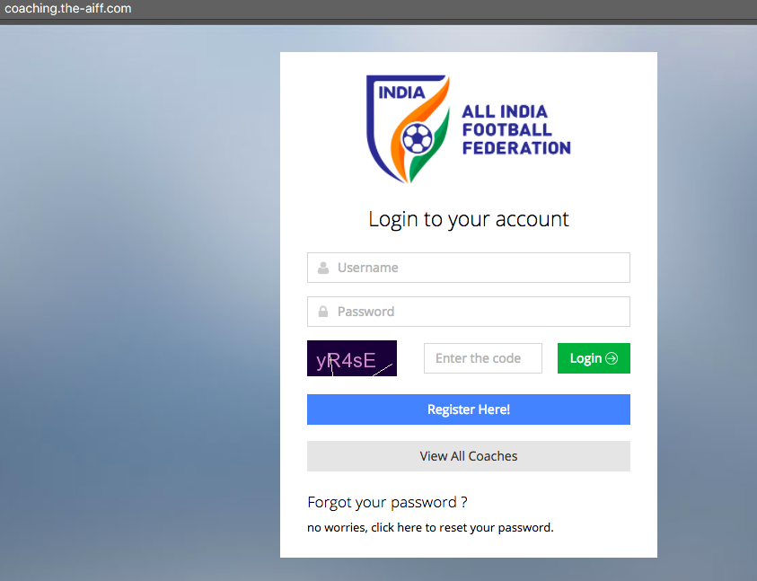
Go to Coaching.the-aiff.com
Click on Register Here!

Slide 3
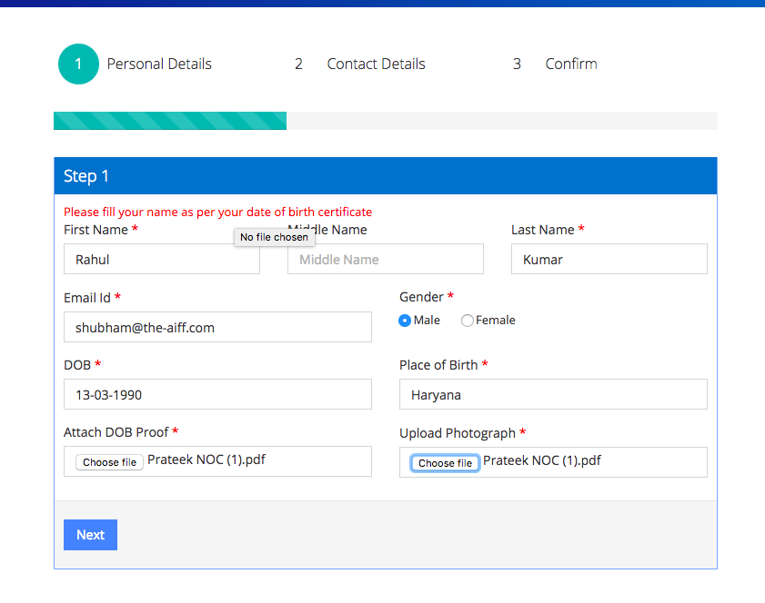
Fill in the details as asked and click on Next.
Please note only the following are acceptable as a birth proof - Aadhar card,10th/12th marksheet, Passport, Date of Birth Certificate (whichever has complete date mentioned).
Photograph must be of JPG format and all other documents in PDF format.

Slide 4
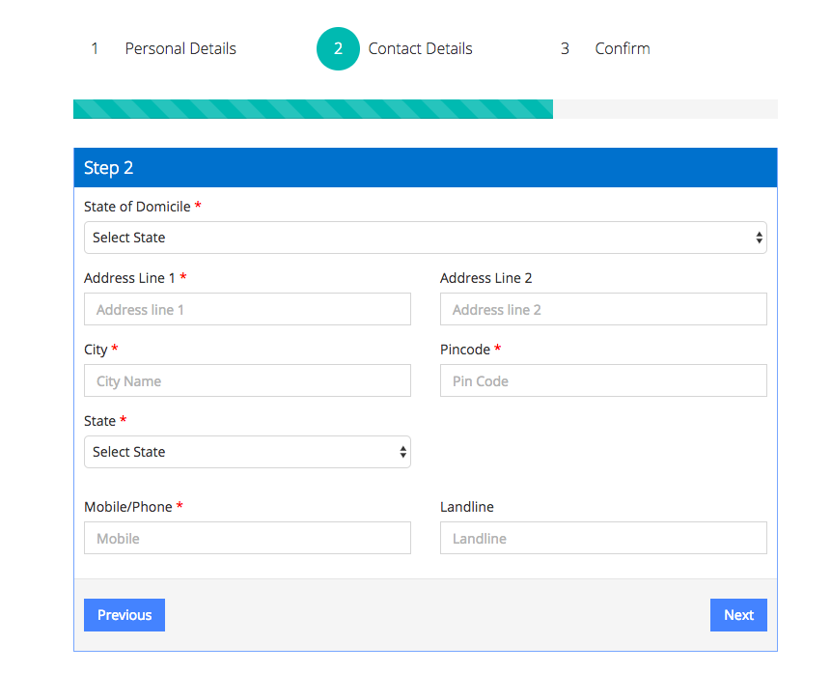
Fill up the required Contact details and Click on next.

Slide 5
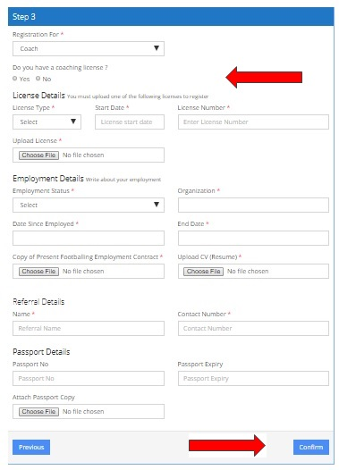
Step 3:
You need to register yourself as a coach under ‘Registration for’ Select ‘Yes’ if you are a licensed coach Upload the copy of your Coaching License.
Select ‘No’ if you are not a licensed coach
Add your employment details with a valid signed Contract and a proper CV in a PDF format.
Details required:
‘Organization Name, Designation, Contract term’
.

Slide 6
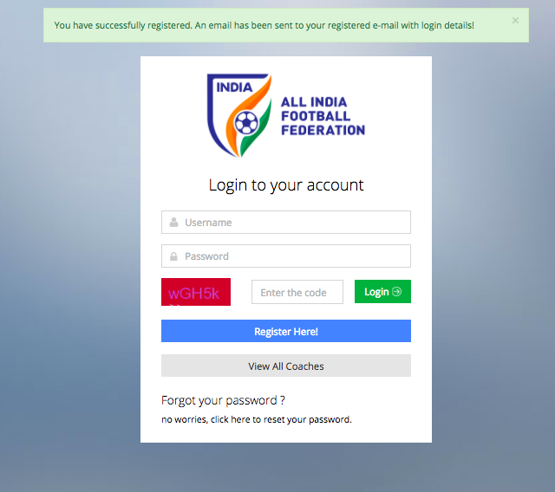
Your profile has been created and is pending for approval by AIFF coaching department.

Slide 7
Contact:
Shubham Kapoor
shubham@the-aiff.com
Shveta Sharma
shveta@the-aiff.com

